Slide 1
Graph Theory Minimum Spanning Tree
Design and Analysis of Algorithms

Slide 2
Minimum Spanning Trees
Spanning Tree
A tree (i.e., connected, acyclic graph) which contains all the vertices of the graph
Minimum Spanning Tree
Spanning tree with the minimum sum of weights
Spanning forest
If a graph is not connected, then there is a spanning tree for each connected component of the graph
b
8
c
7
d
4
9
2
a
11
i
4
14
e
8
7
6
10
g
g
f
1
2

Slide 3
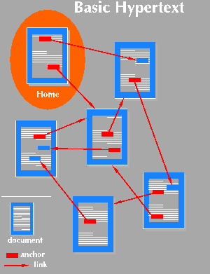
Applications of MST
Find the least expensive way to connect a set of cities, terminals, computers, etc.

Slide 4
Example
b
8
c
7
d
Problem
A town has a set of houses
and a set of roads
A road connects 2 and only
2 houses
A road connecting houses u and v has a repair
cost w(u, v)
Goal: Repair enough (and no more) roads such that:
Everyone stays connected
i.e., can reach every house from all other houses
2. Total repair cost is minimum
9
4
2
a
11
i
4
14
e
8
7
6
10
h
g
f
1
2

Slide 5
Minimum Spanning Trees
A connected, undirected graph:
Vertices = houses, Edges = roads
A weight w(u, v) on each edge (u, v) ∈ E
Find T ⊆ E such that:
T connects all vertices
w(T) = Σ_{(u,v)∈T} w(u, v) is
minimized
b
8
c
7
d
4
9
2
a
11
i
4
14
e
8
7
6
10
h
g
f
1
2

Slide 6
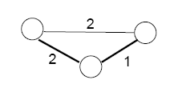
Properties of Minimum Spanning Trees
Minimum spanning tree is not unique
MST has no cycles – see why:
We can take out an edge of a cycle, and still have the vertices connected while reducing the cost
# of edges in a MST:
|V| - 1

Slide 7
Minimum spanning trees
A spanning tree of an undirected connected graph is its connected acyclic subgraph (i.e., a tree) that contains all the vertices of the graph.
If such a graph has weights assigned to its edges, a minimum spanning tree is its spanning tree of the smallest weight, where the weight of a tree is defined as the sum of the
weights on all its edges.
The minimum spanning tree problem is the problem of finding a minimum spanning tree for a given weighted connected graph.

Slide 8
Minimum spanning trees
Input: A connected, undirected graph G = (V, E) with weight function w : E → R.
For simplicity, assume that all edge weights are distinct. (CLRS covers the general case.)
L16.8

Slide 9
Minimum spanning trees
Input: A connected, undirected graph G = (V, E) with weight function w : E → R.
For simplicity, assume that all edge weights are distinct. (CLRS covers the general case.)
Output: A spanning tree T — a tree that connects all vertices — of minimum weight:
w(T ) = ∑ w(u, v) .
(u,v)∈T
L16.9

Slide 10




Example of MST
6 12
5
9
14
7
8
15
3
10
L16.10

Slide 11
Example of MST
6 12
5
9
14
7
8
15
3
10
L16.11

Slide 12
Optimal substructure
MST T:
(Other edges of G
are not shown.)
L16.12

Slide 13
Optimal substructure
MST T:
(Other edges of G
are not shown.)
u
v
Remove any edge (u, v) ∈ T.
L16.13

Slide 14
Optimal substructure
MST T:
(Other edges of G
are not shown.)
u
v
Remove any edge (u, v) ∈ T.
L16.14

Slide 15
Optimal substructure
MST T:
(Other edges of G
are not shown.)
u
T
2
T
1
v
Remove any edge (u, v) ∈ T. Then, T is partitioned into two subtrees T₁ and T₂.
L16.15

Slide 16

Hallmark for “greedy” algorithms
Greedy-choice property A locally optimal choice is globally optimal.
L16.20

Slide 17
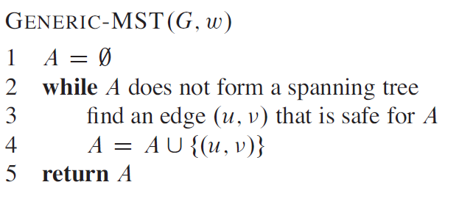
The generic method manages a set of edges A, maintaining the following loop invariant:
Prior to each iteration, A is a subset of some minimum spanning tree.
At each step, we determine an edge {u, v} that we can add to A without violating this invariant, in the sense that A U {u, v] is also a subset of a minimum spanning tree.
We call such an edge a safe edge for A, since we can add it safely to A while maintaining the invariant
Notes:
In computer science, a loop invariant is a property of a program loop that is true before (and after) each iteration. It is a logical assertion, sometimes checked within the code by an assertion call

Slide 18
Hallmark for “greedy” algorithms
Greedy-choice property A locally optimal choice is globally optimal.
Theorem. Let T be the MST of G = (V, E), and let A ⊆ V. Suppose that (u, v) ∈ E is the least-weight edge connecting A to V – A. Then, (u, v) ∈ T.
L16.21

Slide 19








Proof of theorem
Proof. Suppose (u, v) ∉ T. Cut and paste.
T: v
u
∈ A
∈ V – A
(u, v) = least-weight edge connecting A to V – A
L16.22

Slide 20
Proof of theorem
Proof. Suppose (u, v) ∉ T. Cut and paste.
T: v
u
∈ A
∈ V – A
(u, v) = least-weight edge connecting A to V – A
Consider the unique simple path from u to v in T.
L16.23

Slide 21
Proof of theorem
Proof. Suppose (u, v) ∉ T. Cut and paste.
T: v
u
∈ A
∈ V – A
(u, v) = least-weight edge connecting A to V – A
Consider the unique simple path from u to v in T.
Swap (u, v) with the first edge on this path that connects a vertex in A to a vertex in V – A.
L16.24

Slide 22
Proof of theorem
Proof. Suppose (u, v) ∉ T. Cut and paste.
T ′: v
∈ A
u
(u, v) = least-weight edge connecting A to V – A
∈ V – A
Consider the unique simple path from u to v in T.
Swap (u, v) with the first edge on this path that connects a vertex in A to a vertex in V – A.
A lighter-weight spanning tree than T results.
L16.25

Slide 23
Prim’s algorithm
IDEA: Maintain V – A as a priority queue Q. Key each vertex in Q with the weight of the least- weight edge connecting it to a vertex in A.
Q ← V
key[v] ← ∞ for all v ∈ V
key[s] ← 0 for some arbitrary s ∈ V
while Q ≠ ∅
do u ← EXTRACT-MIN(Q)
for each v ∈ Adj[u]
do if v ∈ Q and w(u, v) < key[v]
then key[v] ← w(u, v)
π[v] ← u
⊳ DECREASE-KEY
At the end, {(v, π[v])} forms the MST.
L16.26
Notes:
The greedy strategy advocates making the choice that is the best at the moment. Such a strategy does not generally guarantee that it will always find globally optimal solutions to problems. For the minimum-spanning-tree problem, however, we can prove that certain greedy strategies do yield a spanning tree with minimum weight.

Slide 24




Example of Prim’s algorithm
∈ A
∈ V – A
∞
6 12
∞ ⁵ ∞ ⁹ ∞
14
7
8
15
∞
0 ∞
3
10
∞
L16.27

Slide 25
Example of Prim’s algorithm
∈ A
∈ V – A
∞
6 12
∞ ⁵ ∞ ⁹ ∞
14
7
8
15
∞
0 ∞
3
10
∞
L16.28

Slide 26





Example of Prim’s algorithm
∈ A
∈ V – A
∞
6 12
∞ ⁵ 7 ⁹ ∞
14
7
8
15
∞
0 15
3
10
10
L16.29

Slide 27
Example of Prim’s algorithm
∈ A
∈ V – A
∞
6 12
∞ ⁵ 7 ⁹ ∞
14
7
8
15
∞
0 15
3
10
10
L16.30

Slide 28
Example of Prim’s algorithm
∈ A
∈ V – A
12
5
6
12
9
5
7
9
14
7
8
15
∞
0
15
3
10
10
L16.31

Slide 29
Example of Prim’s algorithm
∈ A
∈ V – A
12
5
6
12
9
5
7
9
14
7
8
15
∞
0
15
3
10
10
L16.32

Slide 30
Example of Prim’s algorithm
∈ A
∈ V – A
6
5
6
12
9
5
7
9
14
7
8
15
14
0
15
3
10
8
L16.33

Slide 31
Example of Prim’s algorithm
∈ A
∈ V – A
6
5
6
12
9
5
7
9
14
7
8
15
14
0
15
3
10
8
L16.34

Slide 32
Example of Prim’s algorithm
∈ A
∈ V – A
6
5
6
12
9
5
7
9
14
7
8
15
14
0
15
3
10
8
L16.35

Slide 33
Example of Prim’s algorithm
∈ A
∈ V – A
6
5
6
12
9
5
7
9
14
7
8
15 ₁₅
3
0
3
10
8
L16.36

Slide 34
Example of Prim’s algorithm
∈ A
∈ V – A
6
5
6
12
9
5
7
9
14
7
8
15 ₁₅
3
0
3
10
8
L16.37

Slide 35
Example of Prim’s algorithm
∈ A
∈ V – A
6
5
6
12
9
5
7
9
14
7
8
15 ₁₅
3
0
3
10
8
L16.38

Slide 36
Example of Prim’s algorithm
∈ A
∈ V – A
6
5
6
12
9
5
7
9
14
7
8
15 ₁₅
3
0
3
10
8
L16.39

Slide 37
Analysis of Prim
Q ← V
key[v] ← ∞ for all v ∈ V
key[s] ← 0 for some arbitrary s ∈ V
while Q ≠ ∅
do u ← EXTRACT-MIN(Q)
for each v ∈ Adj[u]
do if v ∈ Q and w(u, v) < key[v]
then key[v] ← w(u, v)
π[v] ← u
L16.40

Slide 38
Analysis of Prim
Q ← V
key[v] ← ∞ for all v ∈ V
key[s] ← 0 for some arbitrary s ∈ V
while Q ≠ ∅
do u ← EXTRACT-MIN(Q)
for each v ∈ Adj[u]
do if v ∈ Q and w(u, v) < key[v]
then key[v] ← w(u, v)
π[v] ← u
Θ(V)
total
L16.41

Slide 39
Analysis of Prim
Q ← V
key[v] ← ∞ for all v ∈ V
key[s] ← 0 for some arbitrary s ∈ V
while Q ≠ ∅
do u ← EXTRACT-MIN(Q)
for each v ∈ Adj[u]
do if v ∈ Q and w(u, v) < key[v]
then key[v] ← w(u, v)
π[v] ← u
Θ(V)
total
|V |
times
L16.42

Slide 40
Analysis of Prim
Q ← V
key[v] ← ∞ for all v ∈ V
key[s] ← 0 for some arbitrary s ∈ V
while Q ≠ ∅
do u ← EXTRACT-MIN(Q)
Θ(V)
total
|V |
times
for each v ∈ Adj[u]
do if v ∈ Q and w(u, v) < key[v]
then key[v] ← w(u, v)
π[v] ← u
degree(u) times
L16.43

Slide 41
Analysis of Prim
Q ← V
key[v] ← ∞ for all v ∈ V
key[s] ← 0 for some arbitrary s ∈ V
while Q ≠ ∅
do u ← EXTRACT-MIN(Q)
Θ(V)
total
|V |
times
for each v ∈ Adj[u]
do if v ∈ Q and w(u, v) < key[v]
then key[v] ← w(u, v)
π[v] ← u
degree(u) times
Handshaking Lemma ⇒ Θ(E) implicit DECREASE-KEY’s.
L16.44

Slide 42
Analysis of Prim
Q ← V
key[v] ← ∞ for all v ∈ V
key[s] ← 0 for some arbitrary s ∈ V
while Q ≠ ∅
do u ← EXTRACT-MIN(Q)
Θ(V)
total
|V |
times
for each v ∈ Adj[u]
do if v ∈ Q and w(u, v) < key[v]
then key[v] ← w(u, v)
π[v] ← u
degree(u) times
Handshaking Lemma ⇒ Θ(E) implicit DECREASE-KEY’s.
^{Time = Θ(V)·T}EXTRACT-MIN ^{+ Θ(E)·T}DECREASE-KEY
L16.45

Slide 43
Analysis of Prim (continued)
^{Time = Θ(V)·T}EXTRACT-MIN ^{+ Θ(E)·T}DECREASE-KEY
L16.46

Slide 44
Analysis of Prim (continued)
^{Time = Θ(V)·T}EXTRACT-MIN ^{+ Θ(E)·T}DECREASE-KEY
^{Q T}EXTRACT-MIN ^{T}DECREASE-KEY ^{Total}
L16.47

Slide 45
Analysis of Prim (continued)
^{Time = Θ(V)·T}EXTRACT-MIN ^{+ Θ(E)·T}DECREASE-KEY
^{Q T}EXTRACT-MIN ^{T}DECREASE-KEY ^{Total} array O(V) O(1) O(V²)
November 9, 2005
L16.48

Slide 46
Analysis of Prim (continued)
^{Time = Θ(V)·T}EXTRACT-MIN ^{+ Θ(E)·T}DECREASE-KEY
^{Q T}EXTRACT-MIN ^{T}DECREASE-KEY ^{Total}
array
binary heap
O(V) O(1) O(V²)
O(lg V) O(lg V) O(E lg V)
L16.49

Slide 47
Analysis of Prim (continued)
^{Time = Θ(V)·T}EXTRACT-MIN ^{+ Θ(E)·T}DECREASE-KEY
^{Q T}EXTRACT-MIN ^{T}DECREASE-KEY ^{Total}
array
binary heap
Fibonacci heap
O(V) O(1) O(V²)
O(lg V)
O(lg V) amortized
O(lg V)
O(1)
amortized
O(E lg V)
O(E + V lg V)
worst case
L16.50

Slide 48
MST algorithms
Kruskal’s algorithm (see CLRS):
Uses the disjoint-set data structure (see CLRS, Ch. 21).
Running time = O(E lg V).
L16.51

Slide 49
Kruskal’s Algorithm
How is it different from Prim’s algorithm?
Prim’s algorithm grows one
tree all the time
Kruskal’s algorithm grows
multiple trees (i.e., a forest)
at the same time.
Trees are merged together
using safe edges
Since an MST has exactly |V| - 1
edges, after |V| - 1 merges,
we would have only one component
tree1
u
v
tree2

Slide 50
Kruskal’s Algorithm
Kruskal’s algorithm creates a forest of trees
Initially forest consists of N single node trees (and no edges)
Sorts the edges by weight and goes through the edges from least weight to greatest weight
At each step one edge (with least weight) is added so that it joins two trees together
As long as the addition does not create a cycle

Slide 51
Kruskal’s Algorithm
The halting conditions are as follows:
When |V| – 1 edges have been added
In this case we have a minimum spanning tree
We have gone through all edges
A forest of minimum spanning trees on all connected sub-graphs

Slide 52
Kruskal’s Algorithm
The forest is constructed – with each node in a separate tree
The edges are placed in a priority queue
Until we've added n-1 edges (assumption: connected graph)
Extract the cheapest edge from the queue
If it forms a cycle, reject it
Else add it to the forest. Adding it to the forest will join two trees
Every step will have joined two trees in the forest together, so that at the end, there will only be one tree

Slide 53
Kruskal’s Algorithm – Example
Complete Graph
B
4
C
4
2
1
A
4
E
1
F
D
2
3
10
G
5
5
6
3
4
I
H
2
3
J

Slide 54
Kruskal’s Algorithm – Example
4
1
A
B
A
D
B
4
C
4
4
4
B
C
B
D
2
1
10
2
A
4
B
J
C
E
E
F
1
1
5
2
C
F
D
H
D
3
10
6
2
G
5
D
J
E
G
5
6
3
3
5
4
F
G
F
I
I
3
4
H
G
I
G
J
2
3
J
H
2
J
I
3
J

Slide 55
Kruskal’s Algorithm – Example
Sort Edges: In reality priority queue is used
4
1
1
B
C
A
D
C
F
4
2
1
2
2
C
E
E
G
A
4
E
1
F
2
3
H
J
F
G
D
2
3
3
3
10
G
I
I
J
G
5
4
4
5
6
3
A
B
B
D
4
4
4
I
B
C
G
J
H
5
5
3
F
I
D
H
2
J
6
10
D
J
B
J

Slide 56
Kruskal’s Algorithm – Example
Add Edge
4
1
1
B
C
A
D
C
F
4
2
1
2
2
C
E
E
G
A
4
E
1
F
2
3
H
J
F
G
D
2
3
3
3
10
G
I
I
J
G
5
4
4
5
6
3
A
B
B
D
4
4
4
I
B
C
G
J
H
5
5
3
F
I
D
H
2
J
6
10
D
J
B
J

Slide 57
Kruskal’s Algorithm – Example
Add Edge
4
1
1
B
C
A
D
C
F
4
2
1
2
2
C
E
E
G
A
4
E
1
F
2
3
H
J
F
G
D
2
3
3
3
10
G
I
I
J
G
5
4
4
5
6
3
A
B
B
D
4
4
4
I
B
C
G
J
H
5
5
3
F
I
D
H
2
J
6
10
D
J
B
J

Slide 58
Kruskal’s Algorithm – Example
Add Edge
4
1
1
B
C
A
D
C
F
4
2
1
2
2
C
E
E
G
A
4
E
1
F
2
3
H
J
F
G
D
2
3
3
3
10
G
I
I
J
G
5
4
4
5
6
3
A
B
B
D
4
4
4
I
B
C
G
J
H
5
5
3
F
I
D
H
2
J
6
10
D
J
B
J

Slide 59
Kruskal’s Algorithm – Example
Add Edge
4
1
1
B
C
A
D
C
F
4
2
1
2
2
C
E
E
G
A
4
E
1
F
2
3
H
J
F
G
D
2
3
3
3
10
G
I
I
J
G
5
4
4
5
6
3
A
B
B
D
4
4
4
I
B
C
G
J
H
5
5
3
F
I
D
H
2
J
6
10
D
J
B
J

Slide 60
Kruskal’s Algorithm – Example
Add Edge
4
1
1
B
C
A
D
C
F
4
2
1
2
2
C
E
E
G
A
4
E
1
F
2
3
H
J
F
G
D
2
3
3
3
10
G
I
I
J
G
5
4
4
5
6
3
A
B
B
D
4
4
4
I
B
C
G
J
H
5
5
3
F
I
D
H
2
J
6
10
D
J
B
J

Slide 61
Kruskal’s Algorithm – Example
Add Edge
4
1
1
B
C
A
D
C
F
4
2
1
2
2
C
E
E
G
A
4
E
1
F
2
3
H
J
F
G
D
2
3
3
3
10
G
I
I
J
G
5
4
4
5
6
3
A
B
B
D
4
4
4
I
B
C
G
J
H
5
5
3
F
I
D
H
2
J
6
10
D
J
B
J

Slide 62
Kruskal’s Algorithm – Example
Add Edge
4
1
1
B
C
A
D
C
F
4
2
1
2
2
C
E
E
G
A
4
E
1
F
2
3
H
J
F
G
D
2
3
3
3
10
G
I
I
J
G
5
4
4
5
6
3
A
B
B
D
4
4
4
I
B
C
G
J
H
5
5
3
F
I
D
H
2
J
6
10
D
J
B
J

Slide 63
Kruskal’s Algorithm – Example
Add Edge
4
1
1
B
C
A
D
C
F
4
2
1
2
2
C
E
E
G
A
4
E
1
F
2
3
H
J
F
G
D
2
3
3
3
10
G
I
I
J
G
5
4
4
5
6
3
A
B
B
D
4
4
4
I
B
C
G
J
H
5
5
3
F
I
D
H
2
J
6
10
D
J
B
J

Slide 64
Kruskal’s Algorithm – Example
Add Edge
4
1
1
B
C
A
D
C
F
4
2
1
2
2
C
E
E
G
A
4
E
1
F
2
3
H
J
F
G
D
2
3
3
3
10
G
I
I
J
G
5
4
4
5
6
3
A
B
B
D
4
4
4
I
B
C
G
J
H
5
5
3
F
I
D
H
2
J
6
10
D
J
B
J

Slide 65
Kruskal’s Algorithm – Example
Add Edge
4
1
1
B
C
A
D
C
F
4
2
1
2
2
C
E
E
G
A
4
E
1
F
2
3
H
J
F
G
D
2
3
3
3
10
G
I
I
J
G
5
4
4
5
6
3
A
B
B
D
4
4
4
I
B
C
G
J
H
5
5
3
F
I
D
H
2
J
6
10
D
J
B
J

Slide 66
Kruskal’s Algorithm – Example
Add Edge
4
1
1
B
C
A
D
C
F
4
2
1
2
2
C
E
E
G
A
4
E
1
F
2
3
H
J
F
G
D
2
3
3
3
10
G
I
I
J
G
5
4
4
5
6
3
A
B
B
D
4
4
4
I
B
C
G
J
H
5
5
3
F
I
D
H
2
J
6
10
D
J
B
J

Slide 67
Kruskal’s Algorithm – Example
Minimum spanning tree
B
4
C
4
B
C
4
4
2
2
1
1
A
4
E
A
E
1
F
1
F
D
2
3
D
2
10
G
5
G
5
6
3
3
4
I
I
H
H
2
3
2
3
J
J

Slide 68
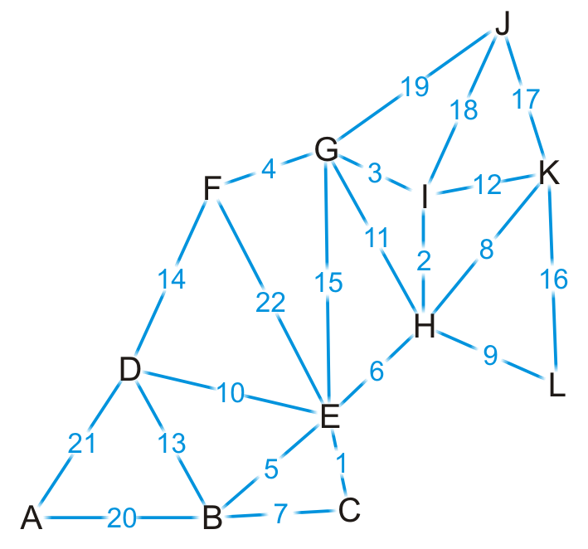
Kruskal’s Algorithm – Example
Complete graph

Slide 69
Kruskal’s Algorithm – Example
{C, E}
{H, I}
{G, I}
{F, G}
{B, E}
{E, H}
{B, C}
{H, K}
{H, L}
{D, E}
{G, H}
{I, K}
{B, D}
{D, F}
{E, G}
{K, L}
{J, K}
{J, I}
{J, G}
{A, B}
{A, D}
{E, F}
Sort edges based on weight

Slide 70

Kruskal’s Algorithm – Example
{C, E}
{H, I}
{G, I}
{F, G}
{B, E}
{E, H}
{B, C}
{H, K}
{H, L}
{D, E}
{G, H}
{I, K}
{B, D}
{D, F}
{E, G}
{K, L}
{J, K}
{J, I}
{J, G}
{A, B}
{A, D}
{E, F}
We start by adding edge {C, E}

Slide 71
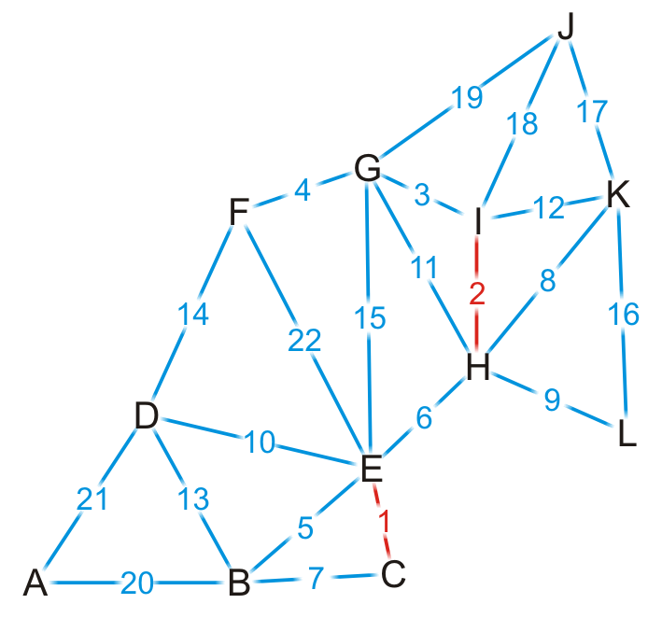
Kruskal’s Algorithm – Example
{C, E}
{H, I}
{G, I}
{F, G}
{B, E}
{E, H}
{B, C}
{H, K}
{H, L}
{D, E}
{G, H}
{I, K}
{B, D}
{D, F}
{E, G}
{K, L}
{J, K}
{J, I}
{J, G}
{A, B}
{A, D}
{E, F}
We add edge {H, I}

Slide 72
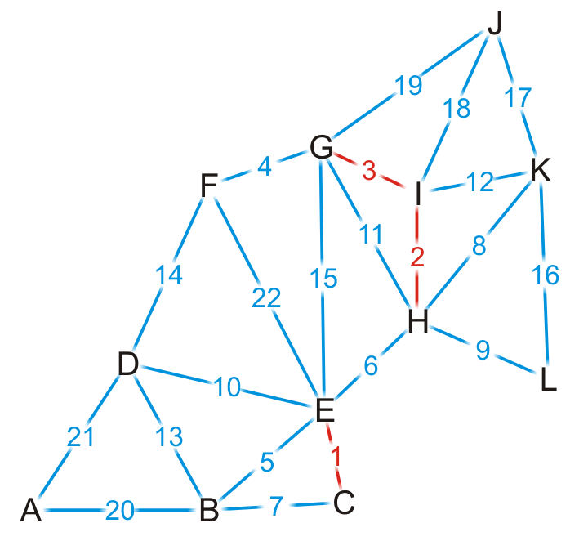
Kruskal’s Algorithm – Example
{C, E}
{H, I}
{G, I}
{F, G}
{B, E}
{E, H}
{B, C}
{H, K}
{H, L}
{D, E}
{G, H}
{I, K}
{B, D}
{D, F}
{E, G}
{K, L}
{J, K}
{J, I}
{J, G}
{A, B}
{A, D}
{E, F}
We add edge {G, I}

Slide 73

Kruskal’s Algorithm – Example
{C, E}
{H, I}
{G, I}
{F, G}
{B, E}
{E, H}
{B, C}
{H, K}
{H, L}
{D, E}
{G, H}
{I, K}
{B, D}
{D, F}
{E, G}
{K, L}
{J, K}
{J, I}
{J, G}
{A, B}
{A, D}
{E, F}
We add edge {F, G}

Slide 74
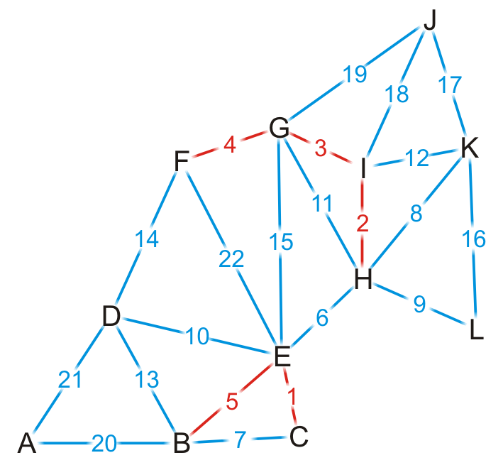
Kruskal’s Algorithm – Example
{C, E}
{H, I}
{G, I}
{F, G}
{B, E}
{E, H}
{B, C}
{H, K}
{H, L}
{D, E}
{G, H}
{I, K}
{B, D}
{D, F}
{E, G}
{K, L}
{J, K}
{J, I}
{J, G}
{A, B}
{A, D}
{E, F}
We add edge {B, E}

Slide 75
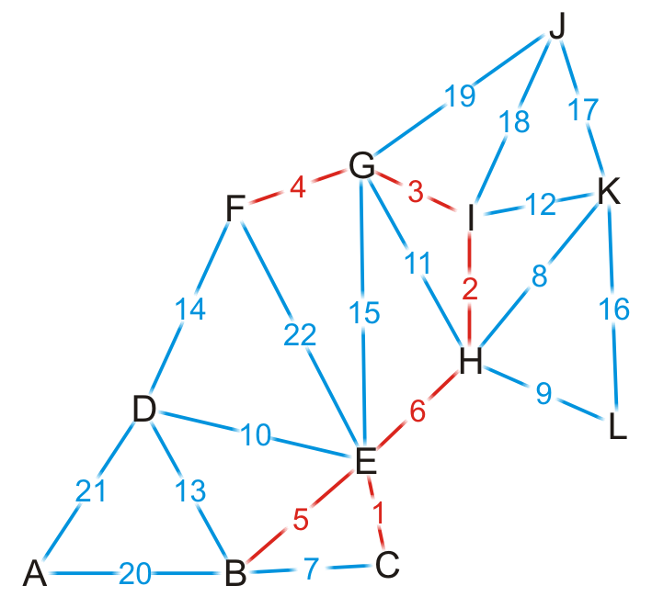
Kruskal’s Algorithm – Example
{C, E}
{H, I}
{G, I}
{F, G}
{B, E}
{E, H}
{B, C}
{H, K}
{H, L}
{D, E}
{G, H}
{I, K}
{B, D}
{D, F}
{E, G}
{K, L}
{J, K}
{J, I}
{J, G}
{A, B}
{A, D}
{E, F}
We add edge {E, H}
This coalesces the two spanning sub-trees into one

Slide 76
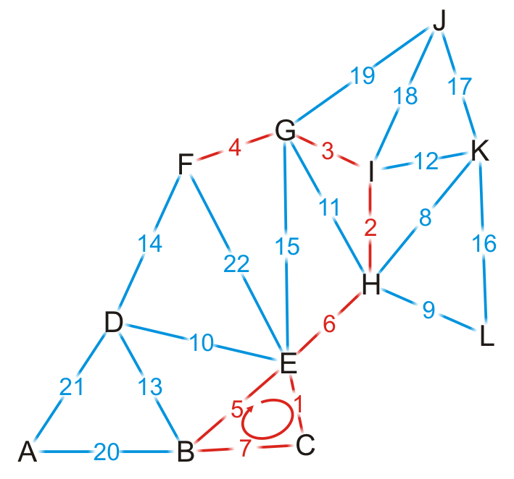
Kruskal’s Algorithm – Example
{C, E}
{H, I}
{G, I}
{F, G}
{B, E}
{E, H}
{B, C}
{H, K}
{H, L}
{D, E}
{G, H}
{I, K}
{B, D}
{D, F}
{E, G}
{K, L}
{J, K}
{J, I}
{J, G}
{A, B}
{A, D}
{E, F}
We try adding {B, C}, but it creates a cycle

Slide 77
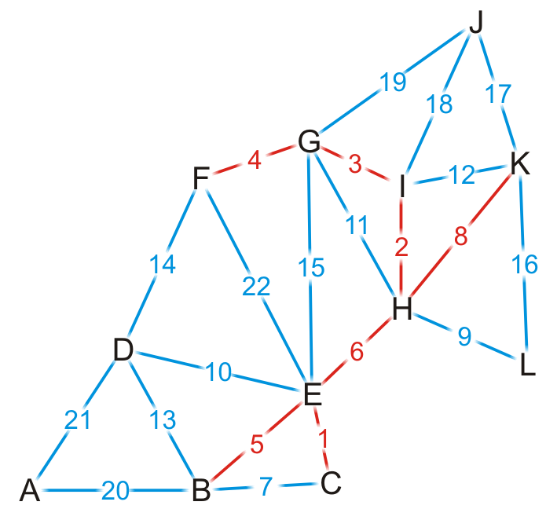
Kruskal’s Algorithm – Example
{C, E}
{H, I}
{G, I}
{F, G}
{B, E}
{E, H}
{B, C}
{H, K}
{H, L}
{D, E}
{G, H}
{I, K}
{B, D}
{D, F}
{E, G}
{K, L}
{J, K}
{J, I}
{J, G}
{A, B}
{A, D}
{E, F}
We add edge {H, K}

Slide 78
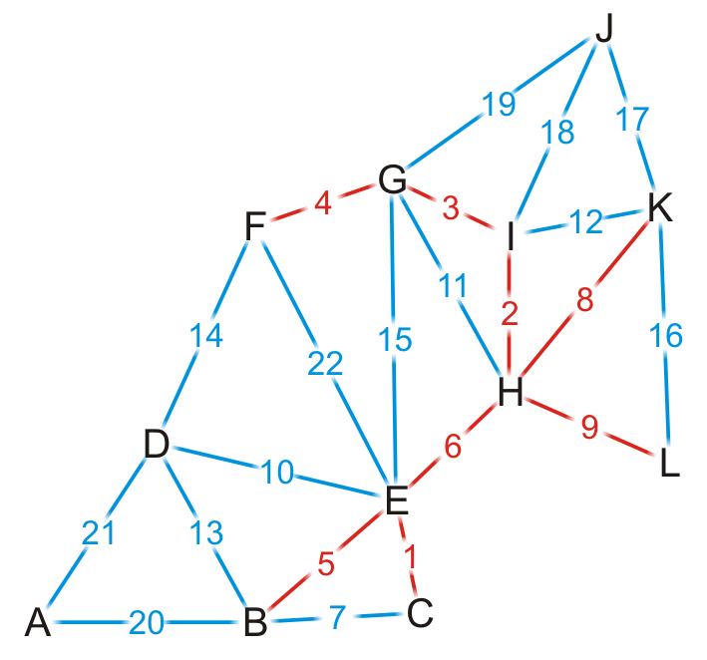
Kruskal’s Algorithm – Example
{C, E}
{H, I}
{G, I}
{F, G}
{B, E}
{E, H}
{B, C}
{H, K}
{H, L}
{D, E}
{G, H}
{I, K}
{B, D}
{D, F}
{E, G}
{K, L}
{J, K}
{J, I}
{J, G}
{A, B}
{A, D}
{E, F}
We add edge {H, L}

Slide 79
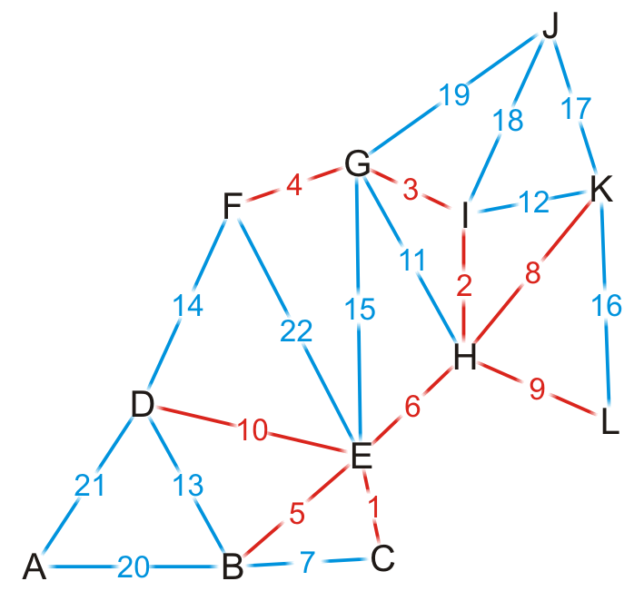
Kruskal’s Algorithm – Example
{C, E}
{H, I}
{G, I}
{F, G}
{B, E}
{E, H}
{B, C}
{H, K}
{H, L}
{D, E}
{G, H}
{I, K}
{B, D}
{D, F}
{E, G}
{K, L}
{J, K}
{J, I}
{J, G}
{A, B}
{A, D}
{E, F}
We add edge {D, E}

Slide 80
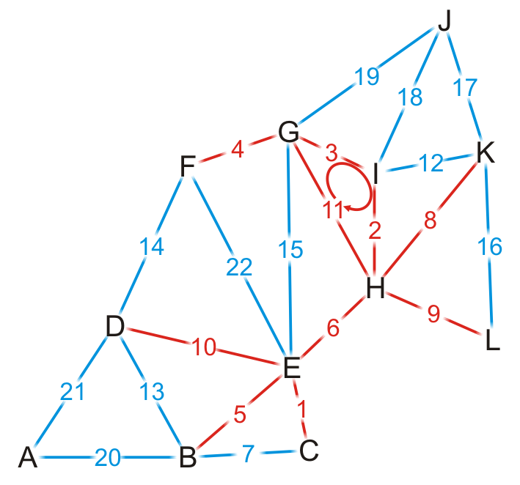
Kruskal’s Algorithm – Example
{C, E}
{H, I}
{G, I}
{F, G}
{B, E}
{E, H}
{B, C}
{H, K}
{H, L}
{D, E}
{G, H}
{I, K}
{B, D}
{D, F}
{E, G}
{K, L}
{J, K}
{J, I}
{J, G}
{A, B}
{A, D}
{E, F}
We try adding {G, H}, but it creates a cycle

Slide 81
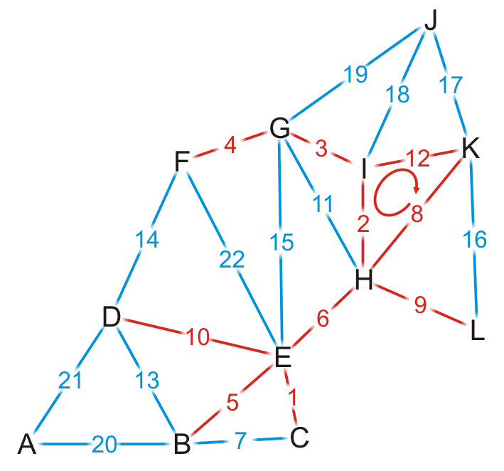
Kruskal’s Algorithm – Example
{C, E}
{H, I}
{G, I}
{F, G}
{B, E}
{E, H}
{B, C}
{H, K}
{H, L}
{D, E}
{G, H}
{I, K}
{B, D}
{D, F}
{E, G}
{K, L}
{J, K}
{J, I}
{J, G}
{A, B}
{A, D}
{E, F}
We try adding {I, K}, but it creates a cycle

Slide 82
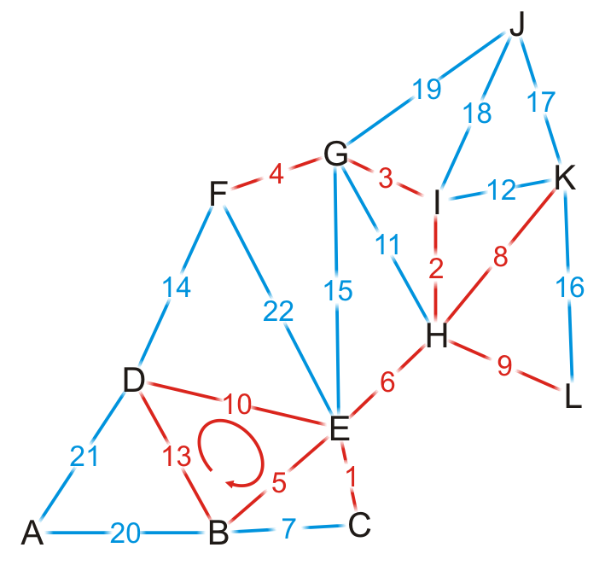
Kruskal’s Algorithm – Example
{C, E}
{H, I}
{G, I}
{F, G}
{B, E}
{E, H}
{B, C}
{H, K}
{H, L}
{D, E}
{G, H}
{I, K}
{B, D}
{D, F}
{E, G}
{K, L}
{J, K}
{J, I}
{J, G}
{A, B}
{A, D}
{E, F}
We try adding {B, D}, but it creates a cycle

Slide 83
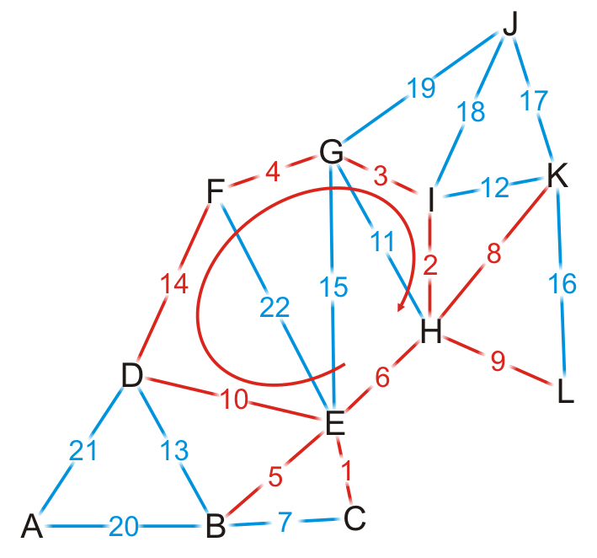
Kruskal’s Algorithm – Example
{C, E}
{H, I}
{G, I}
{F, G}
{B, E}
{E, H}
{B, C}
{H, K}
{H, L}
{D, E}
{G, H}
{I, K}
{B, D}
{D, F}
{E, G}
{K, L}
{J, K}
{J, I}
{J, G}
{A, B}
{A, D}
{E, F}
We try adding {D, F}, but it creates a cycle

Slide 84
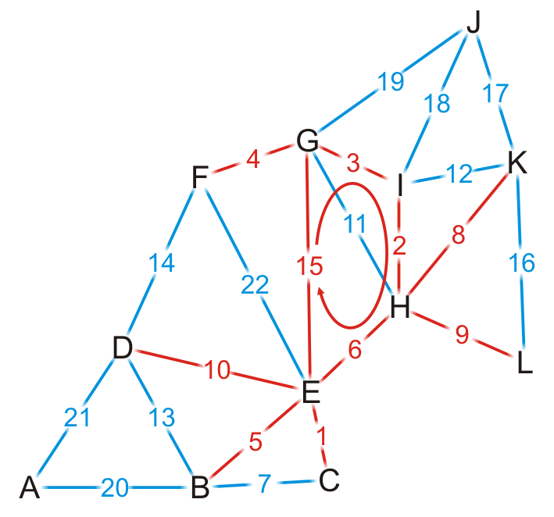
Kruskal’s Algorithm – Example
{C, E}
{H, I}
{G, I}
{F, G}
{B, E}
{E, H}
{B, C}
{H, K}
{H, L}
{D, E}
{G, H}
{I, K}
{B, D}
{D, F}
{E, G}
{K, L}
{J, K}
{J, I}
{J, G}
{A, B}
{A, D}
{E, F}
We try adding {E, G}, but it creates a cycle

Slide 85
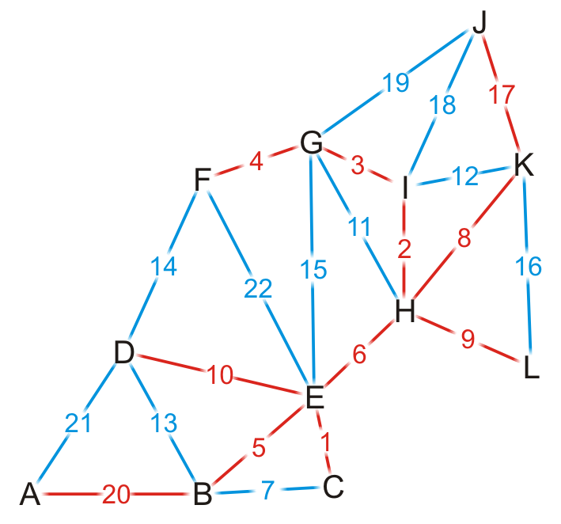
Kruskal’s Algorithm – Example
{C, E}
{H, I}
{G, I}
{F, G}
{B, E}
{E, H}
{B, C}
{H, K}
{H, L}
{D, E}
{G, H}
{I, K}
{B, D}
{D, F}
{E, G}
{K, L}
{J, K}
{J, I}
{J, G}
{A, B}
{A, D}
{E, F}
By observation, we can still add edges {J, K} and {A, B}

Slide 86
Kruskal’s Algorithm – Example
{C, E}
{H, I}
{G, I}
{F, G}
{B, E}
{E, H}
{B, C}
{H, K}
{H, L}
{D, E}
{G, H}
{I, K}
{B, D}
{D, F}
{E, G}
{K, L}
{J, K}
{J, I}
{J, G}
{A, B}
{A, D}
{E, F}
Having added {A, B}, we now have 11 edges
We terminate the loop
We have our minimum spanning tree

Slide 87
Detecting a Cycle
To determine if a cycle is created, we could perform a traversal
A run-time of O(|V|)

Slide 88
Detecting a Cycle – Disjoint Sets
Consider edges in the same connected sub-graph as forming a set
{B, C, E}, {F, G, H, I}

Slide 89
Detecting a Cycle – Disjoint Sets
Consider edges in the same connected sub-graph as forming a set
If the vertices of the next edge are in different sets
Take the union of the two sets
Add edge (E, H)?
{B, C, E}, {F, G, H, I}

Slide 90
Detecting a Cycle – Disjoint Sets
Consider edges in the same connected sub-graph as forming a set
If the vertices of the next edge are in different sets
Take the union of the two sets
Add edge (E, H)?
{B, C, E, F, G, H, I}
{B, C, E}, {F, G, H, I}

Slide 91
Detecting a Cycle – Disjoint Sets
Consider edges in the same connected sub-graph as forming a set
If the vertices of the next edge are in different sets
Take the union of the two sets
Do not add an edge if both vertices are in the same set
Add edge (E, H)?
{B, C, E, F, G, H, I}
{B, C, E}, {F, G, H, I}

Slide 92
KRUSKAL(V, E, w)
A ← ∅
for each vertex v ∈ V
do MAKE-SET(v)
sort E into non-decreasing order by w
for each (u, v) taken from the sorted list
do if FIND-SET(u) ≠ FIND-SET(v)
then A ← A ∪ {(u, v)}
UNION(u, v)
return A
Running time: O(V+ElgE+ElgV)=O(ElgE) – dependent on the implementation of the disjoint-set data structure
O(V)
O(ElgE)
O(E)
O(lgV)

Slide 93
KRUSKAL(V, E, w) (cont.)
A ← ∅
for each vertex v ∈ V
do MAKE-SET(v)
sort E into non-decreasing order by w
for each (u, v) taken from the sorted list
do if FIND-SET(u) ≠ FIND-SET(v)
then A ← A ∪ {(u, v)}
UNION(u, v)
return A
- Running time: O(V+ElgE+ElgV)=O(ElgE)
- Since E=O(V²), we have lgE=O(2lgV)=O(lgV)
O(V)
O(ElgE)
O(E)
O(lgV)
O(ElgV)

Slide 94
Kruskal’s Algorithm
Kruskal’s algorithm is a “greedy” algorithm
Kruskal’s greedy strategy produces a globally optimum solution
Proof for generic approach
applies to Kruskal’s
algorithm too
S
x
u
y
v
V - S

Slide 95
Kruskal’s Algorithm vs Prim’s Algorithm
In prim’s algorithm, graph must be a connected
Kruskal’s algorithm can function on disconnected graphs too
Prim's algorithm is significantly faster for dense graphs with more number of edges than vertices
Kruskal's algorithm runs faster in the case of sparse graphs

Slide 96
Problem 1
(Exercise 23.2-3, page 637) Compare Prim’s algorithm with and Kruskal’s algorithm assuming:
sparse graphs:
In this case, E=O(V)
Kruskal:
O(ElgE)=O(VlgV)
Prim:
- binary heap: O(ElgV)=O(VlgV)
- Fibonacci heap: O(VlgV+E)=O(VlgV)

Slide 97
Problem 1 (cont.)
(b) dense graphs
In this case, E=O(V²)
Kruskal:
O(ElgE)=O(V²lgV²)=O(2V²lgV)=O(V²lgV)
Prim:
- binary heap: O(ElgV)=O(V²lgV)
- Fibonacci heap: O(VlgV+E)=O(VlgV+V²)=O(V²)

Slide 98
Problem 2
Suppose that some of the weights in a connected graph G are negative. Will Prim’s algorithm still work? What about Kruskal’s algorithm? Justify your answers.
Yes, both algorithms will work with negative weights. Review the proof of the generic approach; there is no assumption in the proof about the weights being positive.

Slide 99
Problem 3
Find an algorithm for the “maximum” spanning tree. That is, given an undirected weighted graph G, find a spanning tree of G of maximum cost. Prove the correctness of your algorithm.
Consider choosing the “heaviest” edge (i.e., the edge associated with the largest weight) in a cut. The generic proof can be modified easily to show that this approach will work.
Alternatively, multiply the weights by -1 and apply either Prim’s or Kruskal’s algorithms without any modification at all!

Slide 100
MST algorithms
Kruskal’s algorithm (see CLRS):
Uses the disjoint-set data structure (see CLRS, Ch. 21).
Running time = O(E lg V).
Best to date:
Karger, Klein, and Tarjan [1993].
Randomized algorithm.
O(V + E) expected time.
L16.52

Slide 101
Reference
Introduction to Algorithms
Minimum Spanning Tree
Chapter # 23
Thomas H. Cormen
Disjoint Set
http://www.csl.mtu.edu/cs4321/www/Lectures/Lecture%2019%20-%20Kruskal%20Algorithm%20and%20Dis-joint%20Sets.htm

Slide 102
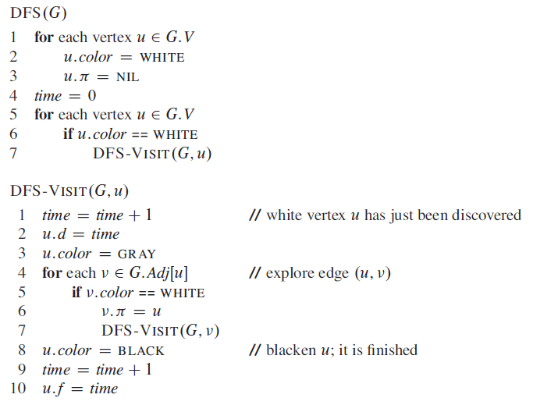
Summary of Graph Algortihms
Breadth-first search
depth-first search
BFS(G, s)
1 for each vertex u V [G] - {s}
2 do color[u] ← WHITE
3 d[u] ← ∞
4 π[u] ← NIL
5 color[s] ← GRAY
6 d[s] ← 0
7 π[s] ← NIL
8 Q ← Ø
9 ENQUEUE(Q, s)
10 while Q ≠ Ø
11 do u ← DEQUEUE(Q)
12 for each v ∈ Adj[u]
13 do if color[v] = WHITE
14 then color[v] ← GRAY
15 d[v] ← d[u] + 1
16 π[v] ← u
17 ENQUEUE(Q, v)
18 color[u] ← BLACK

Slide 103
Analysis of Prim
Q ← V
key[v] ← ∞ for all v ∈ V
key[s] ← 0 for some arbitrary s ∈ V
while Q ≠ ∅
do u ← EXTRACT-MIN(Q)
Θ(V)
total
|V |
times
for each v ∈ Adj[u]
do if v ∈ Q and w(u, v) < key[v]
then key[v] ← w(u, v)
π[v] ← u
degree(u) times
Handshaking Lemma ⇒ Θ(E) implicit DECREASE-KEY’s.
^{Time = Θ(V)·T}EXTRACT-MIN ^{+ Θ(E)·T}DECREASE-KEY
L16.45

Slide 104
KRUSKAL(V, E, w) (cont.)
A ← ∅
for each vertex v ∈ V
do MAKE-SET(v)
sort E into non-decreasing order by w
for each (u, v) taken from the sorted list
do if FIND-SET(u) ≠ FIND-SET(v)
then A ← A ∪ {(u, v)}
UNION(u, v)
return A
- Running time: O(V+ElgE+ElgV)=O(ElgE)
- Since E=O(V²), we have lgE=O(2lgV)=O(lgV)
O(V)
O(ElgE)
O(E)
O(lgV)
O(ElgV)

Slide 105
Shortest Path

